Slide 1

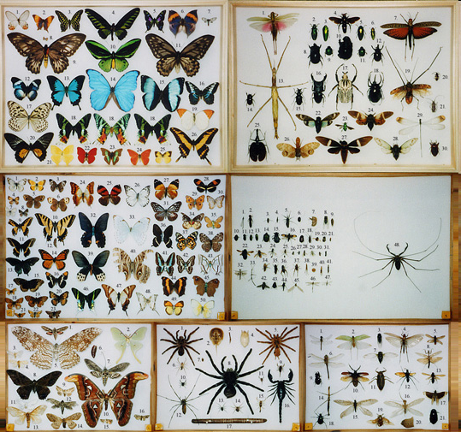
Data Structures III LEFTOVERS
Introduction to Computer Science
Shimon Schocken
IDC Herzliya
Lecture 10-1

Slide 2
Generic types
Specific class
Generic class
/** Represents a box
* that holds an int value */
public class Box {
private int x;
public void set(int x) {
this.x = x;
}
public int get() {
return x;
}
}
/** Represents a generic box that
* can hold objects of any type */
public class Box<T> {
private T x;
public void set(T x) {
this.x = x;
}
public T get() {
return x;
}
}
Generalizing to a generic class that can can handle any data type, T
When we construct a new object of type Box<T>, we must specify what T stands for:
// Client code:
Box<Integer> integerBox = new Box<Integer>();
Box<int> intBox = new Box<int>(); // error
Generic classes cannot handle primitive types. They can handle only object types

Slide 3
Generic types
/** Represents a tool */
public class Tool {
private String description;
public Tool(String description) {
this.description = description;
}
public String toString() {
return description;
}
}
Generic class
/** Represents a generic box that
* can hold objects of any type */
public class Box<T> {
private T x;
public void set(T x) {
this.x = x;
}
public T get() {
return x;
}
}
// Client code
Box<Tool> toolBox = new Box<Tool>();

Slide 4
Generic types
/** Represents a tool */
public class Tool {
private String description;
public Tool(String description) {
this.description = description;
}
public String toString() {
return description;
}
}
Generic class
/** Represents a generic box that
* can hold objects of any type */
public class Box<T> {
private T x;
public void set(T x) {
this.x = x;
}
public T get() {
return x;
}
}
// Client code
Box<Tool> toolBox = new Box<Tool>();
toolBox.set(new Tool("hammer"));
Tool tool = toolBox.get();
System.out.println(tool);
hammer

Slide 5
Generic types
/** Represents a tool */
public class Tool {
private String description;
public Tool(String description) {
this.description = description;
}
public String toString() {
return description;
}
}
Generic class
/** Represents a generic box that
* can hold objects of any type */
public class Box<T> {
private T x;
public void set(T x) {
this.x = x;
}
public T get() {
return x;
}
}
// Client code
Box<Tool> toolBox = new Box<Tool>();
toolBox.set(new Tool("hammer"));
Tool tool = toolBox.get();
System.out.println(tool);
Box<Integer> integerBox = new Box<Integer>();
integerBox.set(new Integer(10));
System.out.println(integerBox.get());
Box<Box> boxInaBox = new Box<Box>();
boxInaBox.set(toolBox);
System.out.println(boxInaBox.get().get());
hammer
10
hammer

Slide 6
Generic types
/** Represents a tool */
public class Tool {
private String description;
public Tool(String description) {
this.description = description;
}
public String toString() {
return description;
}
}
Generic class
/** Represents a generic box that
* can hold objects of any type */
public class Box<T> {
private T x;
public void set(T x) {
this.x = x;
}
public T get() {
return x;
}
}
// Client code

Slide 7
Generic types
/** Represents a tool */
public class Tool {
private String description;
public Tool(String description) {
this.description = description;
}
public String toString() {
return description;
}
}
Generic class
/** Represents a generic box that
* can hold objects of any type */
public class Box<T> {
private T x;
public void set(T x) {
this.x = x;
}
public T get() {
return x;
}
}
// Client code
Box<Tool[]> toolsBox = new Box<Tool[]>();
Tool[] tools = new Tool[3];
tools[0] = new Tool("screwdriver");
tools[1] = new Tool("drill");
tools[2] = new Tool("hammer");
toolsBox.set(tools);
for (Tool t : toolsBox.get()) {
System.out.println(t);
}
screwdriver
drill
hammer

Slide 8
Generic types
A generic class can contain more than one generic type:
/** Represents a generic box
* that holds two objects */
public class BigBox<S,T> {
private S s;
private T t;
public void set(S s, T t) {
this.s = s;
this.t = t;
}
public S gets() {
return s;
}
public T gett() {
return t;
}
}
Commonly used type parameter notation:
S, T, U, V, N, E, ...

Slide 9
Side comment
Specific class
/** Represents a box
* that holds an int value */
public class Box {
private int x;
public void set(int x) {
this.x = x;
}
public int get() {
return x;
}
}
How come the classes that we saw in the last examples have no constructors?
In Java, when you don’t write a constructor, the compiler adds a default constructor (at the level of the generated low-level code)
The default class constructor features a minimal object-construction service (no initialization).
public class Box {
private int x;
}
public class Box {
private int x;
Box() {}
}
As if you wrote:

Slide 10

Plan
Collection examples
Set
Stack
Queue
Map
Generics
Wrapper classes
Generic classes

Slide 11

Queue
remove
add
tail
head
First In, First Out (FIFO)
Queue: a data structure designed to hold an ordered collection of elements with a single entry point and a single exit point.
Elements are added (“enqueued”) to the queue’s “tail”
Elements are removed (“enqueued”) from the queue’s “head”.

Slide 12
Queue
create an empty queue [ ]
add 5 [ 5 ]
add 7 [ 7 5 ]
add 8 [ 8 7 5 ]
x1 = remove // x1 = 5 [ 8 7 ]
x2 = remove // x2 = 7 [ 8 ]
add 2 [ 2 8 ]
add 6 [ 6 2 8 ]
x3 = remove // x3 = 8 [ 6 2 ]
...
First In, First Out (FIFO)
Queue: a data structure designed to hold an ordered collection of elements with a single entry point and a single exit point.
Elements are added (“enqueued”) to the queue’s “tail”
Elements are removed (“enqueued”) from the queue’s “head”.

Slide 13
Queue abstraction
public class Queue {

Slide 14
Queue abstraction
public class Queue {
/** Constructs a stack of the given size. */
public Queue(int maxSize)
/** Adds (addes) the given value to the
* end of this queue */
public void adde(int value) {
/** removes the given value
* (removes and returns the head of the queue) */
public int remove() {
// A few more Queue operations
}
// Client code, in any class

Slide 15
Queue abstraction
public class Queue {
/** Constructs a queue of the given maximum size. */
public Queue(int maxSize)
/** Adds the given value at the queue’s tail */
public void add(int value) {
/** Removes and returns the element at the queue’s head */
public int remove() {
// More Queue methods
}
// Client code, in any class
// Creates three queues
Queue[] qs = new Queue[3];
for (int i = 0; i < qs.length; i++) {
qs[i] = new Queue(); // array of objects!
}
// Inserts the numbers 0 to 9 to the three queues, randomly
for (int i = 0; i < 10; i++) {
int qNumber = (int) (3 * Math.random());
qs[qNumber].adde(i);
}
Simulates the traffic of some service that operates three queues (hospital, factory, etc.)

Slide 16
Queue implementation
Can be implemented using an array
(Similar to the stack implementation)

Slide 17
Queue applications
Job scheduling in hospital ERs, factories, restaurants ...
Job scheduling in operating systems, CPUs, ...
Transactions: banking, communications, web servers, ...
Algorithmic needs: sorting, tree processing ...
Etc.

